Slide 1
Decision Trees

Slide 2
Decision Tree Classifier
Simplest, yet successful form of machine learning algorithm.
Goal: build a model using the training set to classify examples as positive or negative instances of concept .
Decision Tree algorithm constructs a tree consisting of two types of nodes: internal nodes and leaf nodes .
Notes:
Each leaf node has a class label, determined by majority vote of training examples reaching that leaf. 2. Each internal node is a question on features. It branches out according to the answers.

Slide 3
Splitting Attributes
categorical
categorical
continuous
class
Refund
Yes
No
NO
MarSt
Single, Divorced
Married
TaxInc
NO
< 80K
> 80K
NO
YES
Training Data
Model: Decision Tree
Notes:
Each leaf node has a class label, determined by majority vote of training examples reaching that leaf. 2. Each internal node is a question on features. It branches out according to the answers.

Slide 4
Notes:
Decision tree classification task

Slide 5
Apply Model to Test Data
Start from the root of tree.
Test Data
Refund
Yes
No
NO
MarSt
Single, Divorced
Married
TaxInc
NO
< 80K
> 80K
NO
YES

Slide 6
Apply Model to Test Data
Refund
Test Data
Yes
No
NO
MarSt
Single, Divorced
Married
TaxInc
NO
< 80K
> 80K
NO
YES

Slide 7
Apply Model to Test Data
Refund
Test Data
Yes
No
NO
MarSt
Single, Divorced
Married
TaxInc
NO
< 80K
> 80K
NO
YES

Slide 8
Apply Model to Test Data
Refund
Test Data
Yes
No
NO
MarSt
Single, Divorced
Married
TaxInc
NO
< 80K
> 80K
NO
YES

Slide 9
Apply Model to Test Data
Refund
Test Data
Yes
No
NO
MarSt
Single, Divorced
Married
TaxInc
NO
Assign Cheat to “No”
< 80K
> 80K
NO
YES

Slide 10
Decision Tree Algorithms
ID3 (1986 ; Ross Quinlan)
C4.5 (1993; Ross Quinlan)
CART (1984; Breimanetal)

Slide 11
Decision Tree Induction
Greedy strategy: Split the records based on an attribute test that optimizes certain criterion.
Issues
Determine how to split the records
How to specify the attribute test condition?
How to determine the best split?
Determine when to stop splitting

Slide 12
Specify Test Condition in Decision Tree

Slide 13
Decision Tree Induction
Greedy strategy: Split the records based on an attribute test that optimizes certain criterion.
Issues
Determine how to split the records
How to specify the attribute test condition?
How to determine the best split?
Determine when to stop splitting

Slide 14
How to Specify Test Condition?
Depends on attribute types
Nominal
Ordinal
Continuous
Depends on number of ways to split
2-way split
Multi-way split

Slide 15
Splitting based on Nominal Attributes
Multi-way split: Use as many partitions as distinct values.
Binary split: Divides values into two subsets.
CarType
Family
Luxury
Sports
CarType
CarType
{Sports, Luxury}
{Family, Luxury}
{Family}
OR
{Sports}

Slide 16
Splitting based on Odinal Attributes
Multi-way split: Use as many partitions as distinct values.
Binary split: Divides values into two subsets
Size
Small
Large
Medium
Size
Size
{Medium, Large}
{Small, Medium}
{Small}
{Large}
OR

Slide 17
Splitting based on Continuous Attributes
Discretization to form an ordinal categorical attribute
ranges can be found by equal interval bucketing, or clustering.
Binary Decision: (A < v) or (A ≥ v)
consider all possible splits and finds the best cut
can be more compute intensive

Slide 18
Splitting based on Continuous Attributes

Slide 19
Determine the Best Split

Slide 20
Decision Tree Induction
Greedy strategy: Split the records based on an attribute test that optimizes certain criterion.
Issues
Determine how to split the records
How to specify the attribute test condition?
How to determine the best split?
Determine when to stop splitting

Slide 21
How to Determine the Best Split?
Before Splitting: Assume10 records of class 0, 10 records of class 1.
Which test condition is the best?

Slide 22
How to Determine the Best Split?
Greedy approach:
Nodes with homogeneous class distribution are preferred
Need a measure of node impurity:
Non-homogeneous,
High degree of impurity
Homogeneous,
Low degree of impurity

Slide 23
Measures for Node Impurity
Information Gain
Gini Index

Slide 24
Information Gain
Which split is more informative?
Less than 50k Equal to or over 50k
Employed Unemployed

Slide 25
Information Gain
Impurity or Entropy: measures the level of impurity in a group.

Slide 26
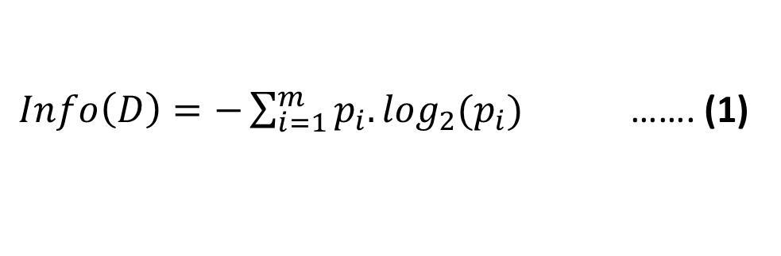
Information Gain
Entropy for Dataset ‘D’ is defined as:
$Info\left(D\right)=−\sum_{i=1}^{m}{p_{i}.\log_{2}(p_{i})}$ ……. (1)
Here, p_{i} is non-zero probability that a tuple in D belongs to class c_{i} and m denotes the number of distinct classes in D.

Slide 27
Information Gain
What is the entropy of a group in which all examples belong to the same class?
entropy = - 1 log₂(1) = 0 Minimum impurity
What is the entropy of a group with 50% in either class?
entropy = -0.5 log₂(0.5) – 0.5 log₂(0.5) =1 Max. impurity

Slide 28
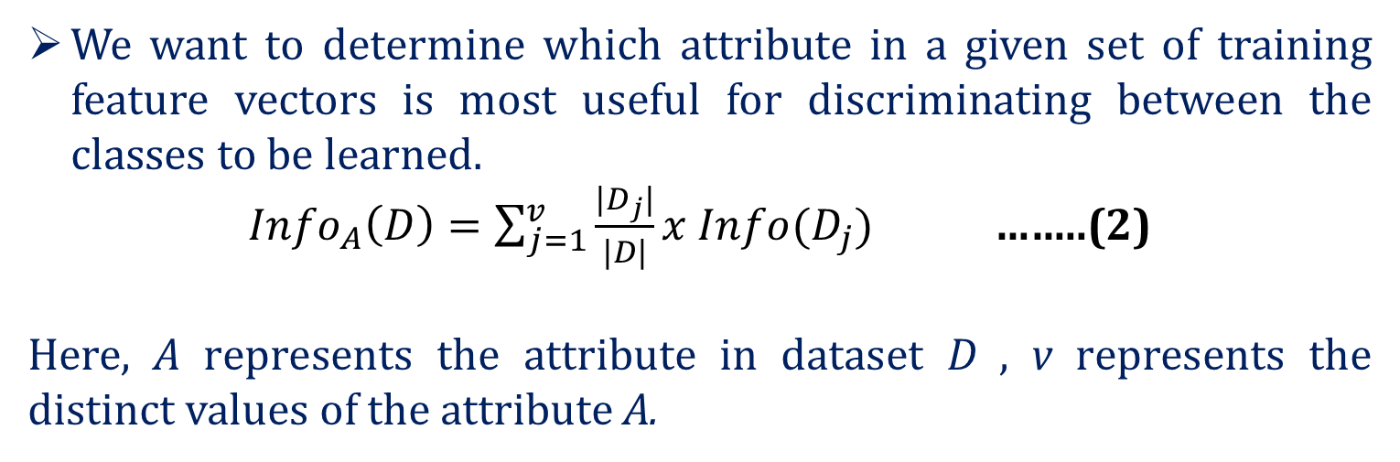
Information Gain
We want to determine which attribute in a given set of training feature vectors is most useful for discriminating between the classes to be learned.
${Info}_{A}\left(D\right)=\sum_{j=1}^{v}{\frac{{|D}_{j}|}{|D|}}x Info(D_{j})$……..(2)
Here, A represents the attribute in dataset D , v represents the distinct values of the attribute A.

Slide 29
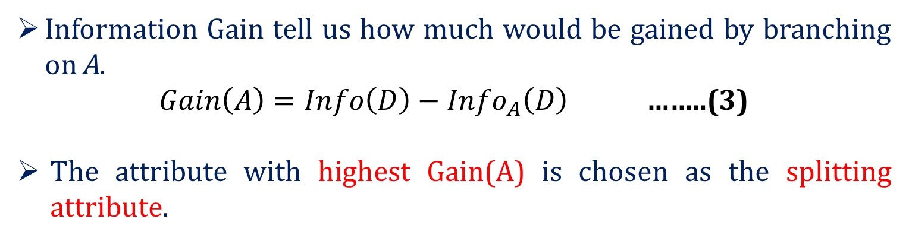
Information Gain
Information Gain tell us how much would be gained by branching on A.
$Gain\left(A\right)={Info\left(D\right)−Info}_{A}\left(D\right)$……..(3)
The attribute with highest Gain(A) is chosen as the splitting attribute.

Slide 30

ID | Age | Income | Student | Credit_Rating | Buys_computer
1 | youth | high | no | fair | NO
2 | youth | high | no | excellent | NO
3 | middle | high | no | fair | YES
4 | senior | medium | no | fair | YES
5 | senior | low | yes | fair | YES
6 | senior | low | yes | excellent | NO
7 | middle | low | yes | excellent | YES
8 | youth | medium | no | fair | NO
9 | youth | low | yes | fair | YES
10 | senior | medium | yes | fair | YES
11 | youth | medium | yes | excellent | YES
12 | middle | medium | no | excellent | YES
13 | middle | high | yes | fair | YES
14 | senior | medium | no | excellent | NO

Slide 31
Calculating Information Gain
Calculate Info(D) using eq. (1):
Info(D)=-9/14.log₂(9/14) - 5/14.log₂(5/14) = 0.940 bits
Calculate Info_{Age}(D) using eq. (2):
Info_{Age}(D)=5/14x(-2/5.log₂(2/5)-3/5.log₂(3/5)) + 4/14x(-4/4.log₂(4/4)- 0) + 5/14x(-3/5.log₂(3/5)-2/5.log₂(2/5)) = 0.694 bits
youth
senior
middle

Slide 32
Calculating Information Gain
Calculate Gain(Age) using eq. (3):
Gain(Age) = Info(D) - Info_{Age}(D)= 0.940 - 0.694 = 0.246 bits
Similarly,
Gain(Income) = 0.029 bits
Gain(Student)= 0.151 bits
Gain (Credit-rating)=0.048 bits

Slide 33
Calculating Information Gain
Since, Age has the highest Info. Gain, so Age will be the splitting attribute.
Age
Income | Student | Credit-Rating | Buys-computer
High | No | Fair | No
High | No | Excellent | No
Medium | No | Fair | No
Low | Yes | Fair | Yes
Medium | Yes | Excellent | Yes
youth
senior
Income | Student | Credit-Rating | Buys-computer
Medium | No | Fair | Yes
Low | Yes | Fair | Yes
Low | Yes | Excellent | no
Medium | Yes | Fair | yes
Medium | No | Excellent | No
middle
YES
Leaf node (4 records)

Slide 34
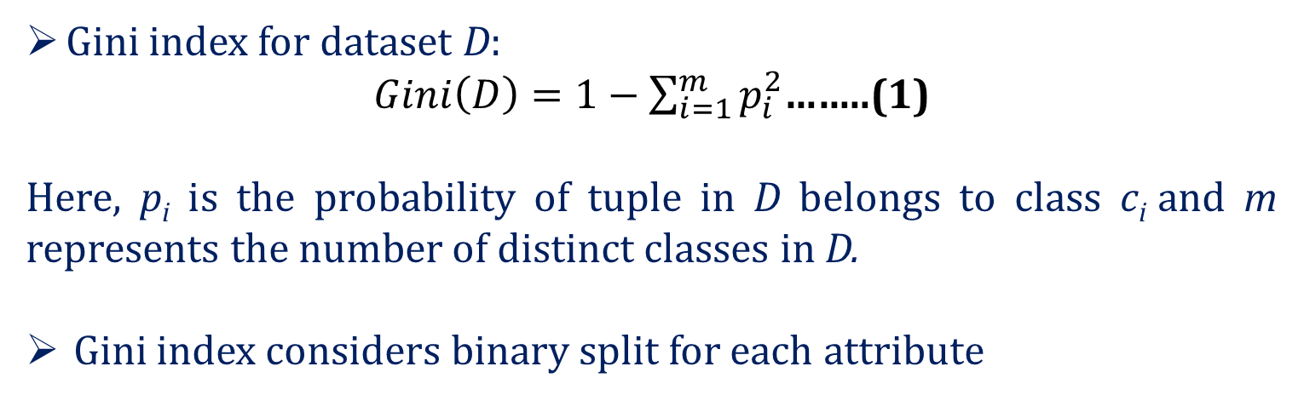
Gini Index
Gini index for dataset D:
$Gini\left(D\right)=1−\sum_{i=1}^{m}{p_{i}^{2}}$……..(1)
Here, p_{i}is the probability of tuple in D belongs to class c_{i} and m represents the number of distinct classes in D.
Gini index considers binary split for each attribute

Slide 35
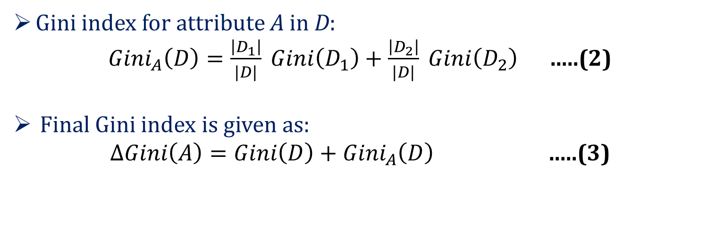
Gini Index
Gini index for attribute A in D:
${Gini}_{A}\left(D\right)=\frac{\left|D_{1}\right|}{|D|} Gini\left(D_{1}\right)+\frac{\left|D_{2}\right|}{|D|} Gini\left(D_{2}\right)$ …..(2)
Final Gini index is given as:
$ΔGini\left(A\right)=Gini\left(D\right)+{Gini}_{A}\left(D\right)$ …..(3)

Slide 36
Gini Index
The attribute which maximizes the reduction in impurity is selected as the best splitting attribute.

Slide 37
Stopping Criteria for DT Algorithm

Slide 38
Decision Tree Induction
Greedy strategy: Split the records based on an attribute test that optimizes certain criterion.
Issues
Determine how to split the records
How to specify the attribute test condition?
How to determine the best split?
Determine when to stop splitting

Slide 39
Stopping Criteria for Decision Tree
Stop expanding a node when all the records belong to the same class.
Stop expanding a node when all the records have similar attribute values.
Early termination.

Slide 40
Overfitting and Underfitting

Slide 41
Model Overfitting
Errors of classification model: Training Errors , Generalization Errors
Training Errors: Number of misclassification errors of the model on training set.
Generalization Errors: Expected error of the model on the previously unseen data.

Slide 42
Model Overfitting
Good model: Low training error as well as low generalization error.
Model that fits too well on the training data can have a poorer generalization error than a model with higher training error, leading to model overfitting.

Slide 43
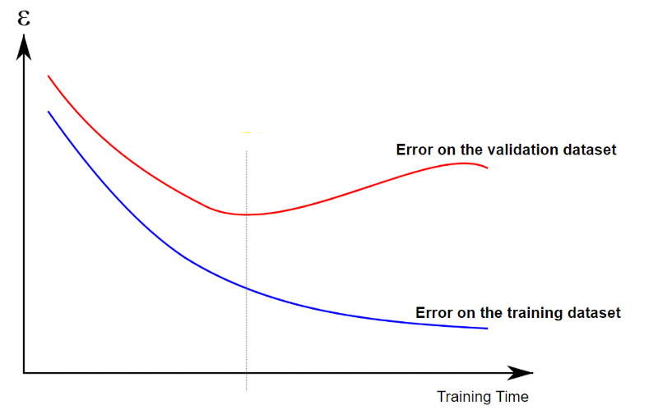
Model Overfitting
Underfitting: training and testing error rates will be high when the size of tree is very small.
As the number of nodes increases, fewer training and testing errors
When the tree becomes too large, the testing error starts increasing whereas training error continue to decrease.
Underfitting
Overfitting

Slide 44
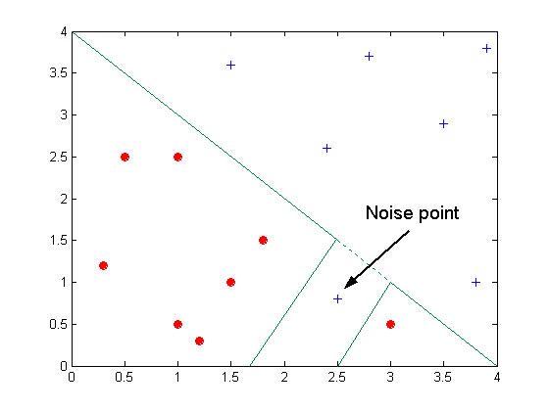
Overfitting due to Noise
Decision boundary is distorted due to noise.

Slide 45
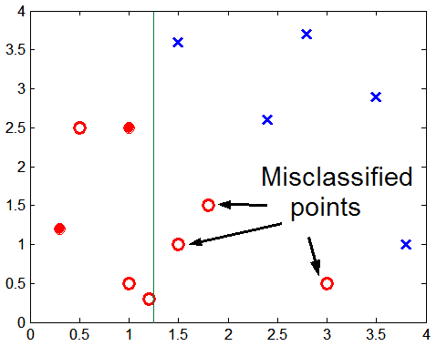
Overfitting due to Insufficient Samples
Lack of data points in the lower half of the diagram makes it difficult to predict correctly the class labels of that region.
Notes:
Lack of data points in the lower half of the diagram makes it difficult to predict correctly the class labels of that region
- Insufficient number of training records in the region causes the decision tree to predict the test examples using other training records that are irrelevant to the classification task

Slide 46
Occam’s Razor
Given two models of similar generalization errors, prefer the simpler model over the more complex model.
For complex models, there is a greater chance that it fitted accidentally by errors in data.
Therefore, model complexity should be considered when evaluating a model.

Slide 47
How to Control Overfitting?
Pre-Pruning (Early Stopping Rule)
Stop the algorithm before it becomes a fully-grown tree
Stop if number of instances is less than some user-specified threshold
Stop if class distribution of instances are independent of the available features
Stop if expanding the current node does not improve impurity measures (e.g., Gini or information gain).

Slide 48
How to Control Overfitting?
Post-pruning
Grow decision tree to its entirety
Trim the nodes of the decision tree in a bottom-up fashion
If generalization error improves after trimming, replace sub-tree by a leaf node.
Class label of leaf node is determined from majority class of instances in the sub-tree

Slide 49
Thank You

